Slide 1
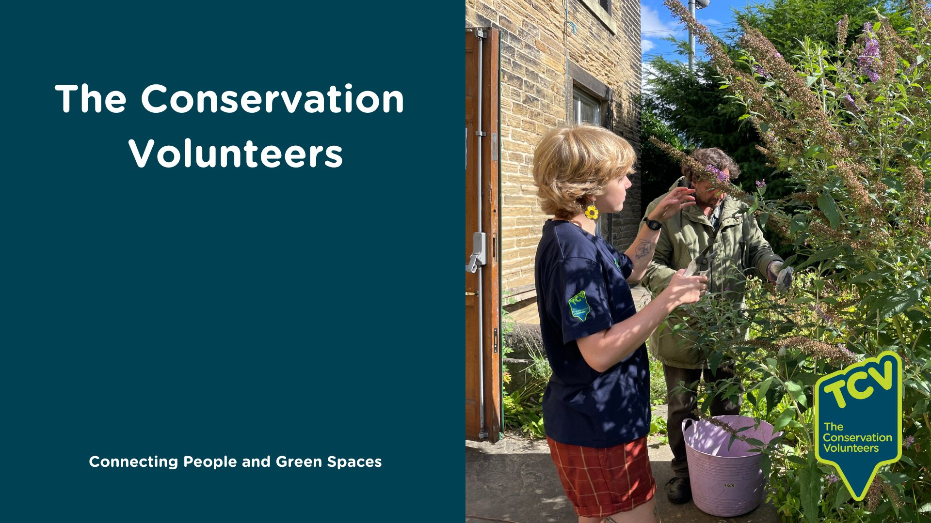
The Conservation Volunteers
Recruitment Pack
Connecting people and green spaces
Better Nature For All

Slide 2
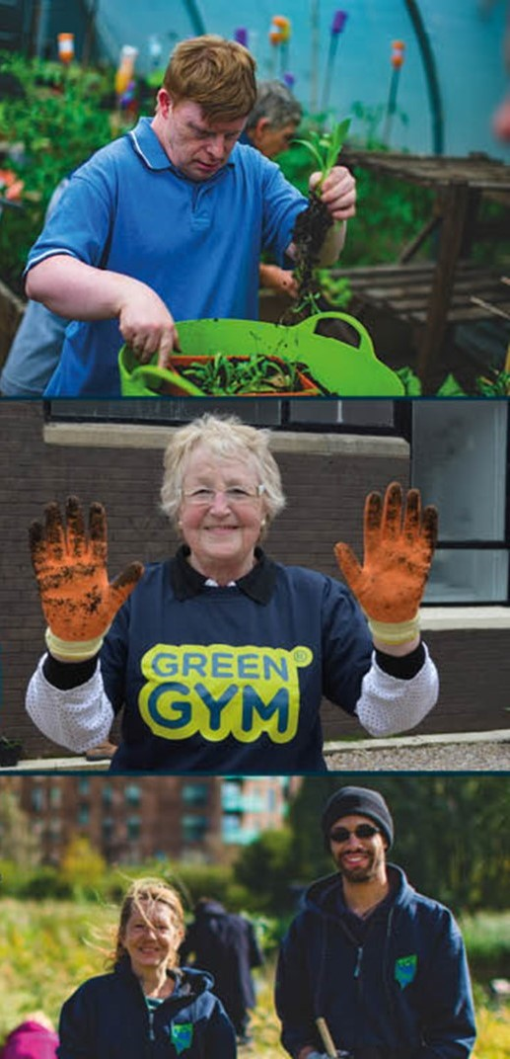
The Conservation Volunteers
In this pack:
Who we are – our Vision & Mission
Our Goals
TCV Values
Operational Framework
Safeguarding Adults and Children
Our Commitment to Equality, Diversity and Inclusion
Benefits of working for TCV
“I love working at TCV because …”

Slide 3
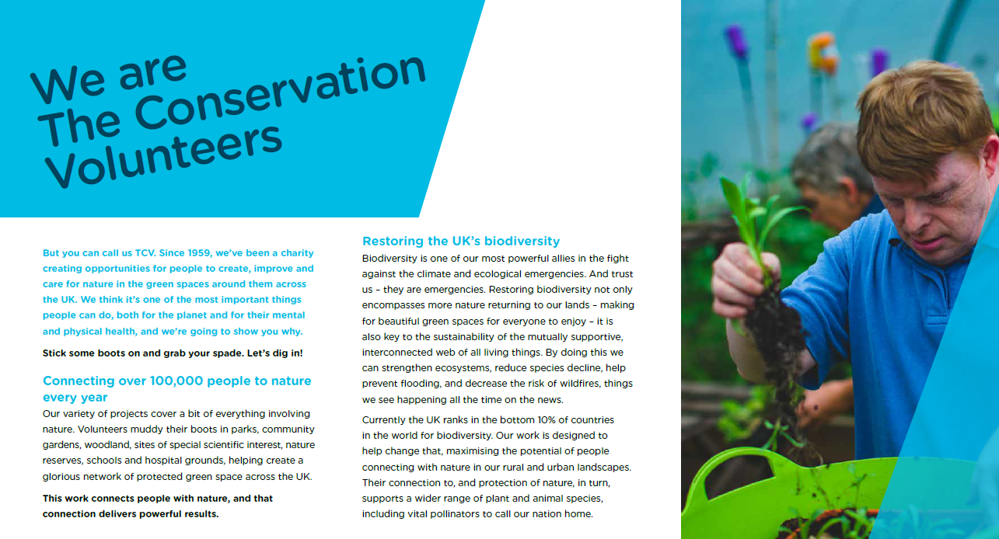

Slide 4


Slide 5


Slide 6
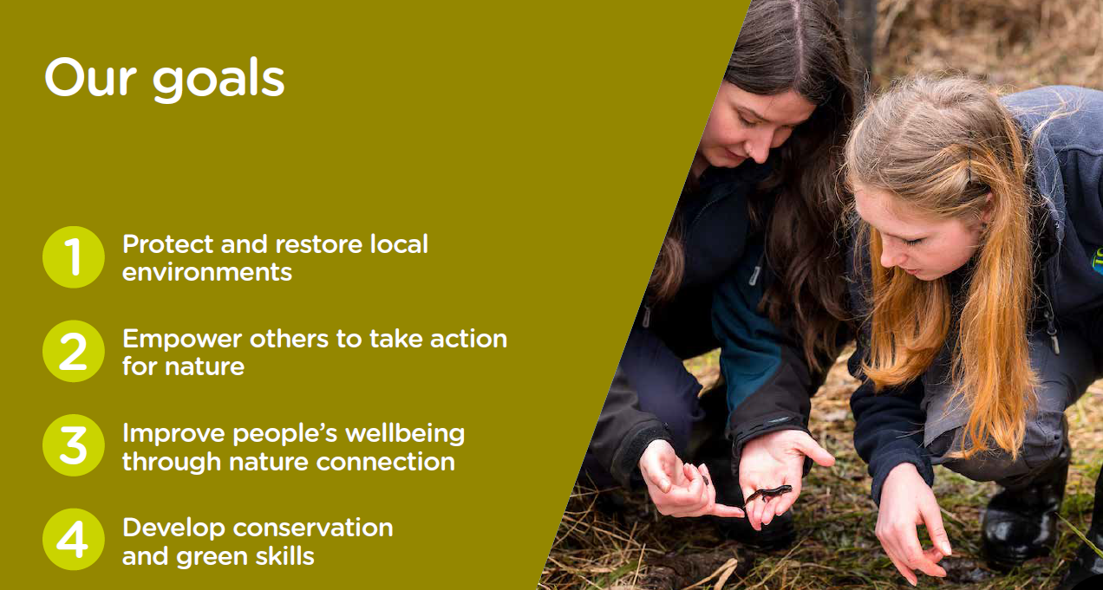

Slide 7
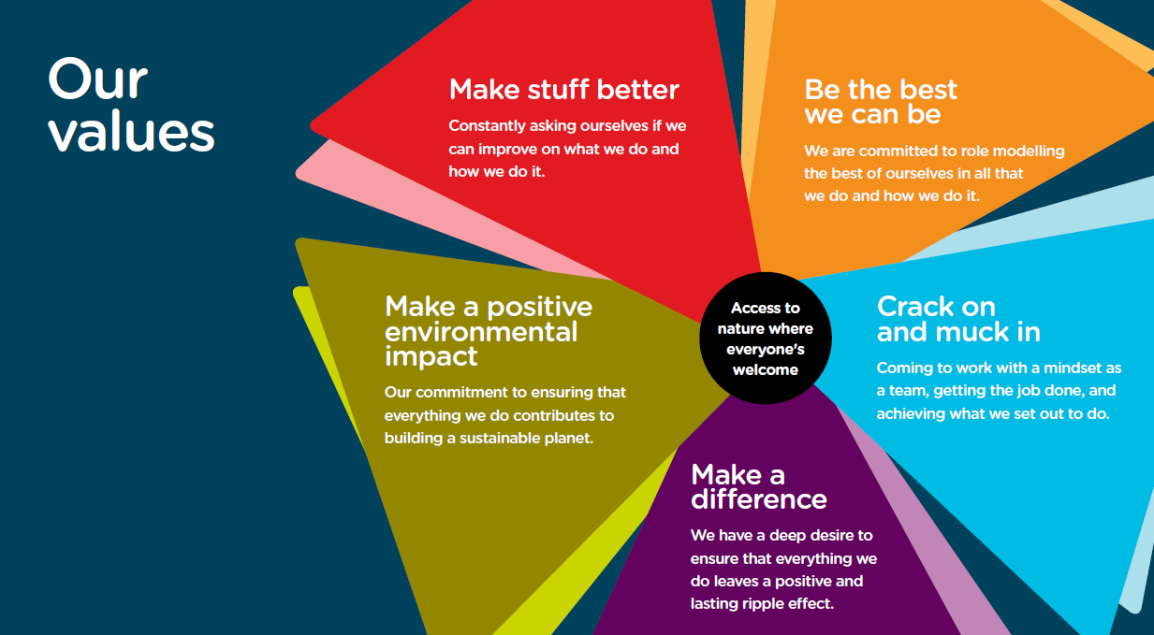
‘Our values are the guiding principles that drive our mission and shape our everyday actions.
These values are not just words; they are the foundation of our identity and the driving force behind every project and initiative at The Conservation Volunteers. They reflect our dedication to excellence, teamwork, impactful change, personal and professional integrity, and our unwavering commitment to the environment’.

Slide 8
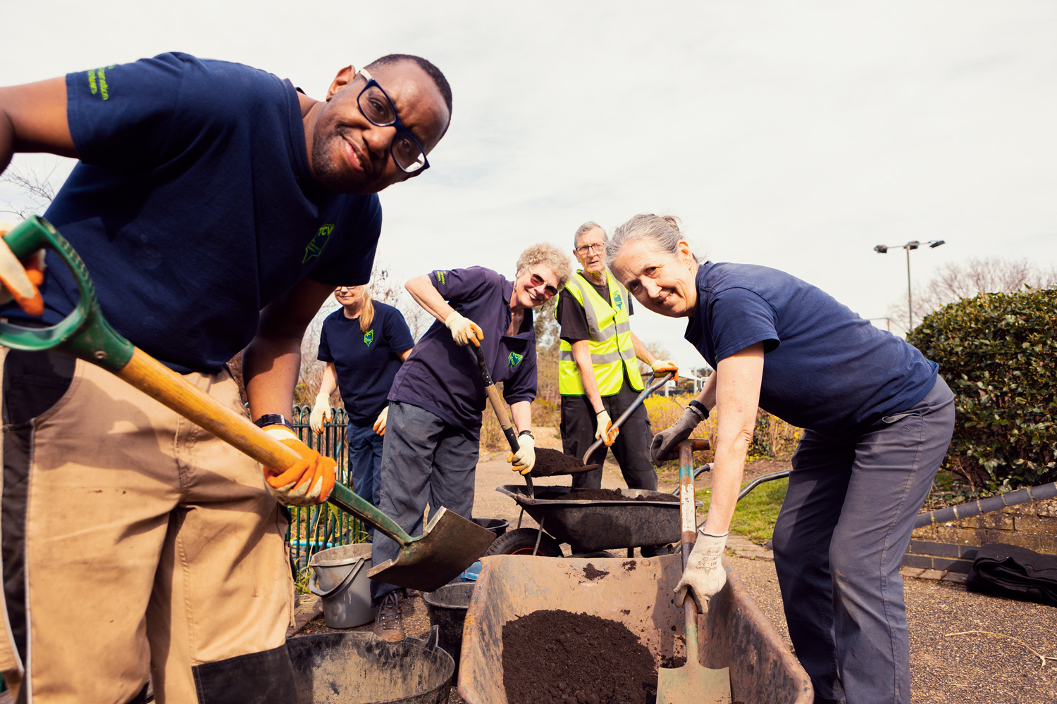
Operational Framework
All of our roles within the organisation are mapped against our Operational Framework
The job description links to this Framework detailing the requirements of the role
The Operational Framework can be found here.

Slide 9
Safeguarding Adults and Children
Safeguarding Children and Adults at Risk is a core requirement for all services delivered by TCV.
A significant number of the volunteers, beneficiaries and visitors who attend TCV projects and sites are Children and/or Adults at Risk.
Therefore, as a TCV employee, you will be required to –
Always act in accordance with your responsibility to safeguard the health and wellbeing of children and vulnerable adults.
Read and adhere to the organisational Safeguarding policies and procedures and participate in related mandatory training.

Slide 10
Our Commitment to Equality, Diversity and Inclusion
We are dedicated to fostering a culture of equality, diversity, and inclusion within our organisation. Our commitment means actively reflecting on and addressing issues related to these principles in every aspect of our operations. We strive to identify disparities and take concrete, effective actions to reduce inequality. This includes creating policies that promote diversity, offering training programs to enhance awareness and understanding, and establishing support systems to ensure an inclusive environment for all employees. By prioritising these values, we aim to build a workplace where everyone feels respected, valued, and empowered to contribute their best. We welcome applications from anyone regardless of age, disability, ethnicity, heritage, gender, sexuality, religion or socio-economic background.
As a Disability Confident Employer, we guarantee first-stage interviews to disabled applicants meeting the minimum job criteria. Our commitment extends beyond compliance to fostering a supportive, inclusive environment where diverse talents thrive. We actively encourage disabled candidates to apply and provide necessary adjustments during recruitment. Through tailored support and ongoing development, we ensure every team member can contribute effectively. Join us in building a workplace where diversity is celebrated, empowering both our team and our ability to serve with empathy and understanding.
During the application process, we promise to:
•Cover your travel expenses to and from the office for in-person interviews (up to a maximum of £15.00).
•Accommodate any reasonable adjustments you may require, such as arranging sign language interpreters in advance.
•Ensure this document is easily downloadable in Word format.
If you wish to seek further information, please email the People Services Team at recruitment@tcv.org.uk

Slide 11
Benefits of working for TCV
Holiday Entitlement
We want all our employees to have a healthy work life balance and positively promote the requirement for adequate rest breaks. We offer 26 days holiday, including Christmas Eve plus all recognised bank/public holidays of your choice. On top of this we give an additional day’s holiday per full year of service, up to a maximum of 31 days. Part-time employees’ entitlements are calculated on a pro-rata basis, dependant on hours worked.
Public holidays are not allocated to any specific faiths/religious events, therefore can be used flexibly across the year . Holidays for part-time employees and those working compressed hours will be expressed in hours but will be based on the full-time equivalent as above.
Holiday entitlements are as follows, which are full time equivalents from 01 April 2025 to 31 March 2026:
England – 256 hours, including Christmas Eve and all bank/public holidays
Scotland – 270 hours, including Christmas Eve and all bank/public holidays
Northern Ireland – 277 hours, including Christmas Eve and all bank/public holidays
Voluntary Pension Scheme
We know how important it is to prepare for the future and want to play a part in enabling a financially secure retirement with our flexible tax-efficient pension plan. If you contribute a minimum of 3.5% of your salary, we will contribute the equivalent of 5% of your salary into your pension fund. Our plan also has flexible retiring options and if you leave TCV, you can take your plan with you.

Slide 12
Benefits of working for TCV
Living Wage Foundation Employer
We are proud to be a Living Wage Employer and are one of only a small number of UK charities that hold this accreditation. This means we have a commitment to pay the ‘real’ living wage as set by the Living Wage Foundation. This is also reviewed annually.
London Weighting Allowance
It is widely acknowledged that living in London is more expensive than other parts of the UK, therefore if you work in one of the London Boroughs, we will pay £3,882 (pro rata for part time workers) in addition to your base salary.
Flexible / Hybrid Working
We understand our workplace offer means different things to different people, that’s why we are happy to talk flexible working. We support employees to work in innovative ways with both formal and informal approaches to flexible working arrangements. We can’t promise we can offer you what you want, but we will always do our best.
Your Learning
Is paramount to TCV as it forms the cornerstone of growth and progress within our organisation. As well as our development days we use shadowing, mentoring networks, online resources, robust inductions, action learning sets, and practical training to develop, upskill and empower employees to adapt, collaborate, and innovate, ensuring TCV remains agile and competitive in a rapidly evolving market.

Slide 13
Benefits of working for TCV
Development Leave
Paid leave (up to a maximum of 1 week in any rolling 12 months period) available to employees who are working on an approved TCV conservation task or development opportunity.
Health & Wellbeing
At TCV, we offer a wide variety of ways to support your health and wellbeing, from internal training courses to access to external services, all supported by our leaders and colleagues across the organisation.
We are also a Mindful Employer and a Disability Confident Committed Employer.
Health Assured – Employee Assistance Programme
We want our people to be physically and emotionally supported. Our Health Assured programme is a free and confidential telephone helpline available 24 hours a day, 7 days a week for all employees and their families on any issues they feel they need support, either in their work or personal lives.
Life Assurance
This scheme provides your loved ones with financial security should something happen to you. All employees will be given the assurance of two times their annual salary.

Slide 14
Benefits of working for TCV
Unum – Help@Hand
A free-to-access service, supporting employees and their families* with remote GP access, mental health, physiotherapy, medical second opinions, life, money and wellbeing support as well as a wellbeing calendar.
Employee Recognition
We like to recognise Long Service milestones which are awarded with vouchers from 5 - 50 years (in increments of 5), as well as personal recognition from our CEO. Our Employee of the Quarter awards and nominations are voted for by all colleagues.
Cycle to Work Scheme
You can purchase a bike and accessories up to the value of £1,000 using the salary sacrifice scheme. Repayments are taken from your gross salary meaning that you pay less Income Tax and NI contributions.
Sick Pay
We have our own discretionary sick pay scheme, including full pay for a period subject to certain conditions.

Slide 15
Benefits of working for TCV
Employee Networks
At TCV we are proud to support a range of active employee networks. Open to all TCV employees, they promote and support what matters to our colleagues.
Family Friendly Workplace
We know how important family is and understand that there may be times where you will need to be away from work (in addition to annual leave). This is why we offer our employees a variety of leave options including maternity, paternity, adoption, shared paternal, career breaks, bereavement leave and others.
Childcare – Did You Know?
You can get up to £500 every 3 months (£2,000/year) for each of your children to help with the costs of childcare. If you get Tax-Free Childcare, the government will pay £2 for every £8 you pay your childcare provider.

Slide 16
“I love working at TCV because *…”
* Actual employee quotes from our yearly People Survey
We are just one of the best organisations around. There is a real desire in from everyone to do the best we can to help others. I'm not just moving numbers around in boxes or making profits, I'm making a difference every day.
We do amazing work that has meaning, purpose and value and makes a difference in the world.
The team I work with are fantastic, supportive and I enjoy working with them. A really supportive manager always available to listen and support even when they are busy. The flexibility in my current role is essential to my everyday life of school and nursey timings and pick up/drop offs. It's also great working for an organisation you really believe in what they do.
The people who work for TCV are all passionate and like-minded. They drive me on to be the best I can be in my role. As well as working with people, I am a people person and what we deliver for our volunteers always puts a smile on my face when they are enjoying themselves.
There is a culture between peers to help and support each other across projects and to help where we can which is amazing.
86% of employees agree or strongly agree with the statement “Overall, my employee experience at TCV meets my expectations”

Slide 17
“I love working at TCV because *…”
* Actual employee quotes from our yearly People Survey
The philosophy of the organisation & the opportunities that these present for our environmental needs going forwards is very positive and I hope to play a big part in its expansion.
TCV is providing me with the appropriate opportunities to progress in a career in wildlife conservation through practical and leadership skills.
I am supported by leaders and colleagues, and I am offered good opportunities in my role. I can see the positive impact that my work is having on the environment. I learn daily and enjoy coming to work.
Love the volunteers and staff. Get fit. My job is involving, stimulating, interesting and gives me a sense of purpose. Great opportunities to further my job-related skills. I improve myself as a person working here.
I can be myself and get to support others to do so too while enhancing nature in my local area.
I feel valued and challenged whilst contributing to the cause I am passionate about.

Slide 18
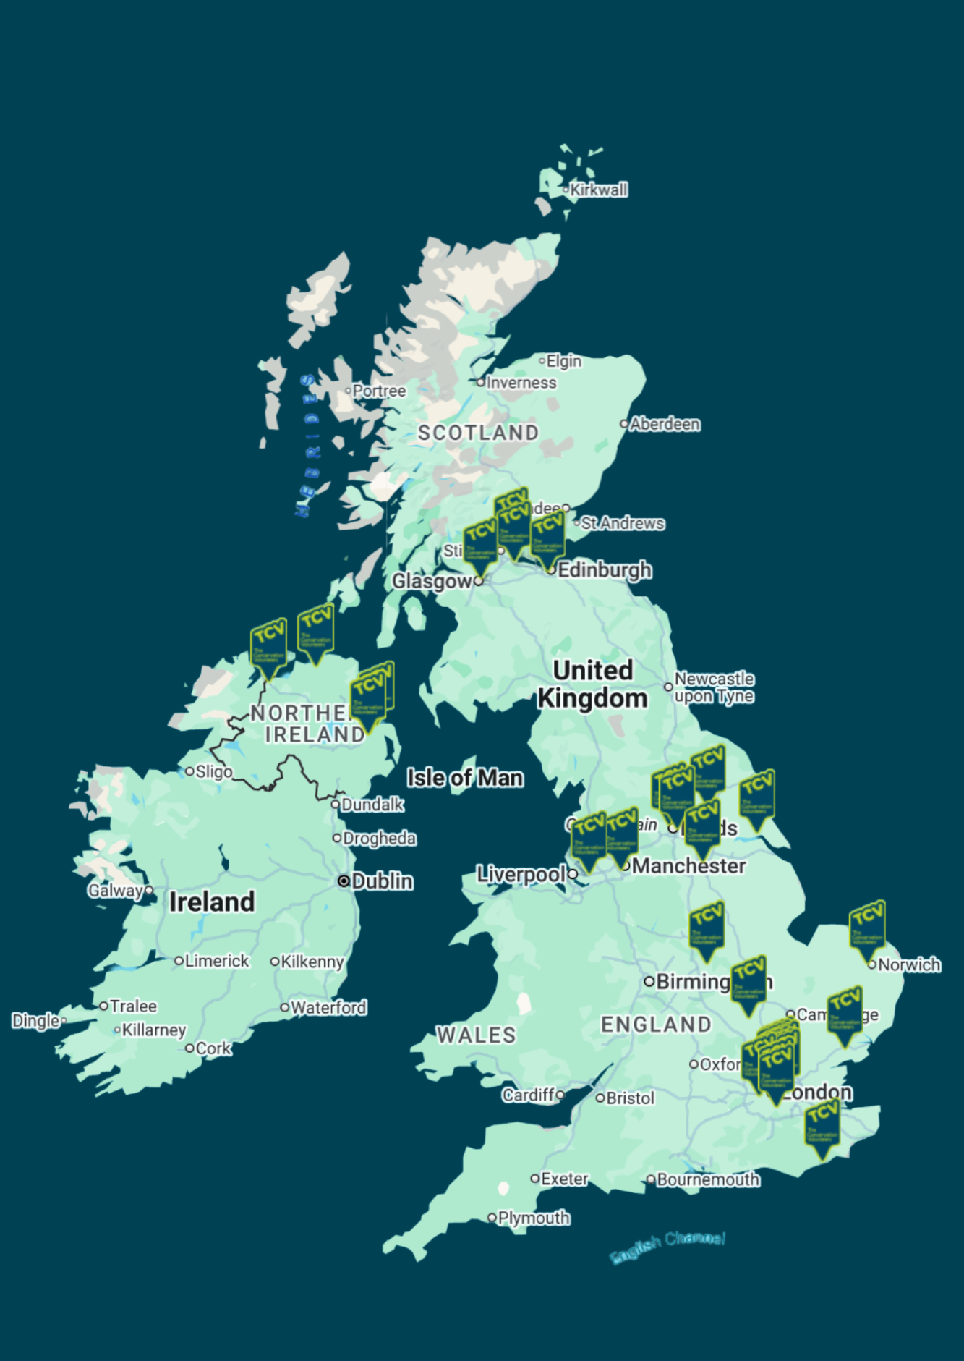
The Conservation Volunteers
The local charity with a national reach.
Here at TCV we have 4 outcomes which are the basis of all the work we do. These are:
Protect and restore local environments
Empower others to take action for nature
Improve people’s wellbeing through nature connection
Develop conservation and green skills
We connect people and green spaces, not only to care for our natural environment, but to provide people with a sense of community, with vital skills and training, and the ability to look after their physical and mental health.

Slide 19
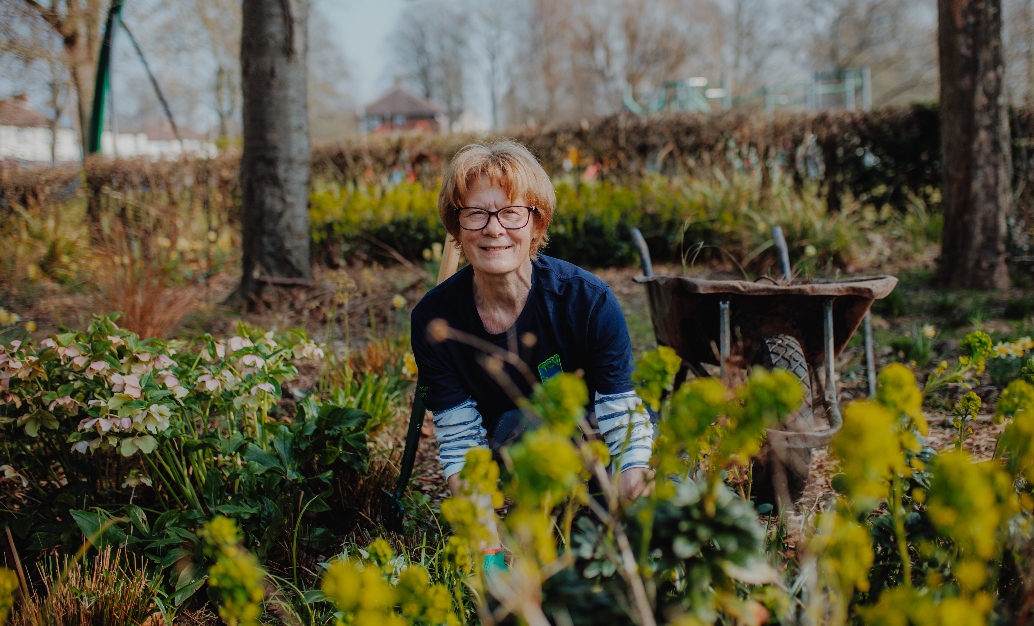

We will connect people together to protect and restore nature, delivering lasting benefits for both.
Our teams of dedicated, passionate staff and volunteers work with communities across England, Northern Ireland, and Scotland.
Through our community network, we support local community groups across the UK.
Keep up to date with the latest news and activities from The Conservation Volunteers by following us on Facebook, LinkedIn, X, Instagram and YouTube.
You can also sign up to receive TCV’s Greenzine newsletter for more ways to get involved.

